Slide 1
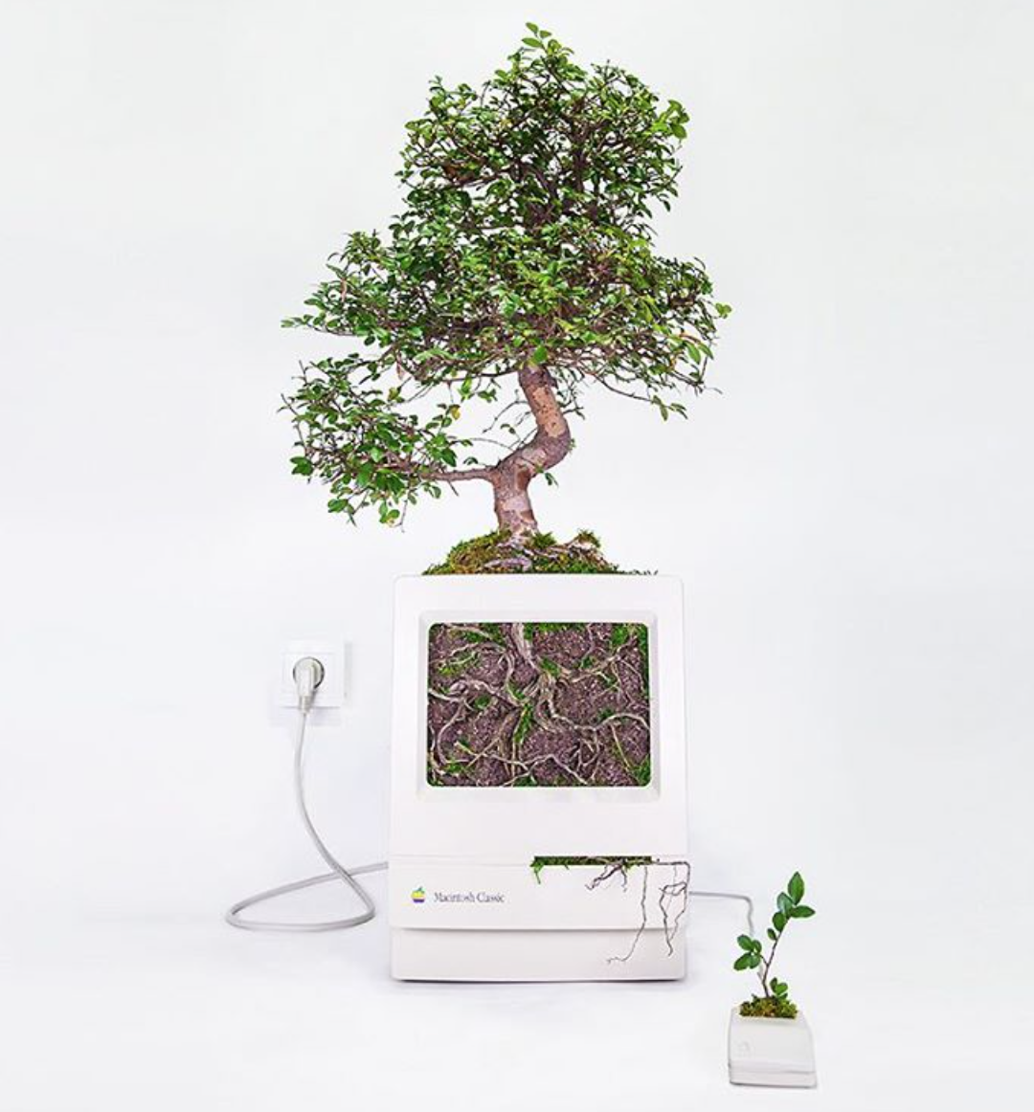

QU-GENE WORKSHOP
Date: October 29, 2021
Presenter: Jennifer Lin, McGill University
Supervisor: Dr. Valerio Hoyos-Villegas
NAPB Monthly Workshop

Slide 2
OUTLINE
Introduction
Workflow
Running the Qu-Gene engine
example.xlsx
Simulation input (.qug file)
Running the QuLinePlus module
Gene-environment system (.ges file)
Breeding strategy (.qmp file)
Parental population (.pop file)
Processing simulation output
Genetic gain (.fit file)
Allele fixation rate (.fix file)
Hamming distance (.ham file)
Genetic variance (.var file)

Slide 3
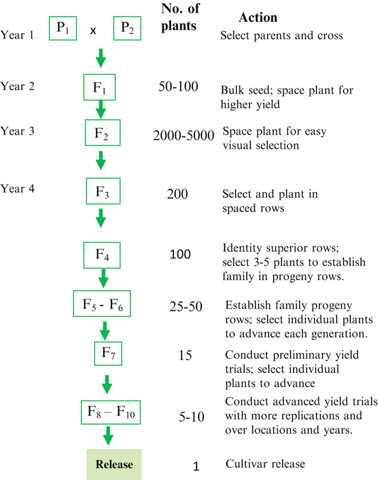
INTRODUCTION
Plant breeding programs can take decades to complete
Computer simulations can provide information, which could not be obtained empirically, in a matter of days
Example of the pedigree method. Acquaah G. (2015) https://doi.org/10.1007/978-3-319-22521-0_5

Slide 4
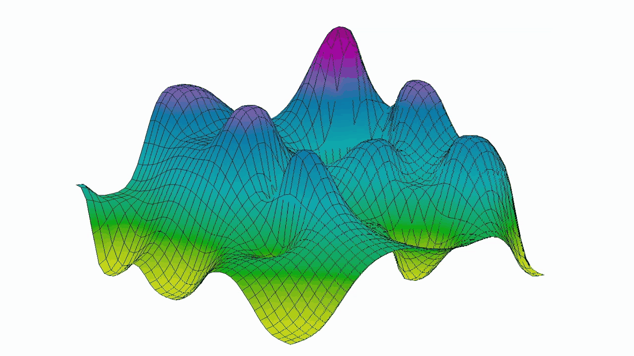
INTRODUCTION
Qu-Gene is a stochastic simulation software
Stochastic vs. deterministic?
E(N:K) model
Simulates genotype-by-environment interactions
QU-GENE

Slide 5
WORKFLOW
.fit file
Qu-Gene
engine
.ges file
QuLinePlus module
For estimating genetic gain
.qug file
.fix file
Contains the following:
Traits
Environments
Error variances
Linkage map
QTL of genes
Markers
Populations
Diagnostics
.pop file
For estimating allele fixation rate
.ham file
.qmp file
For estimating Hamming distance

Slide 6
Qu-Gene Engine
The input file for the Qu-Gene engine is called the .qug file
This contains information on:
Traits
Environments
Error variances
Linkage map
QTL of genes
Markers
Populations
Diagnostics

Slide 7
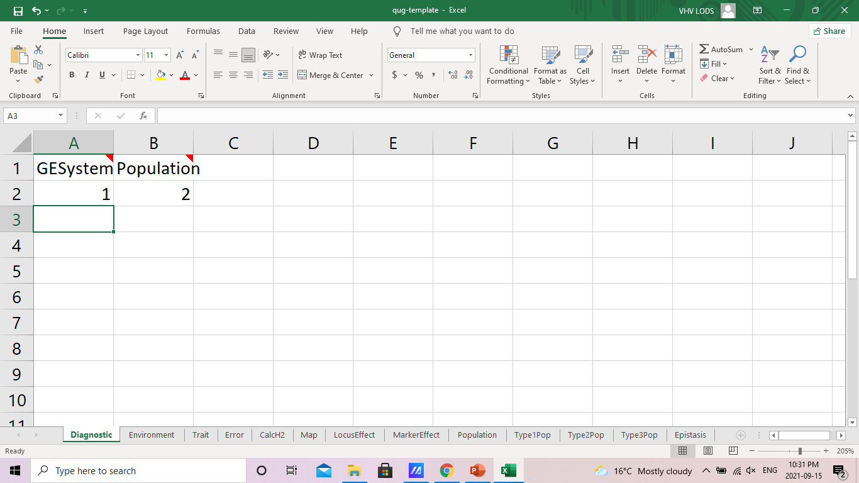
Qu-Gene Engine
Open the file titled “example.xlsx”
You can input information in these sheets

Slide 8
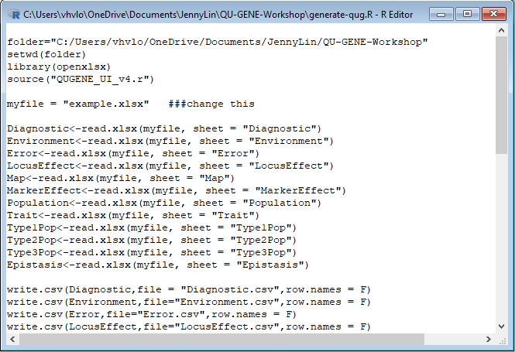
Qu-Gene Engine
Open the script titled “generate-qug.R”
Make sure the file “QUGENE_UI_v4.R” is in your working directory
Make sure the package “openxlsx” is installed:
install.packages(“openxlsx”)
Change this to your working directory

Slide 9
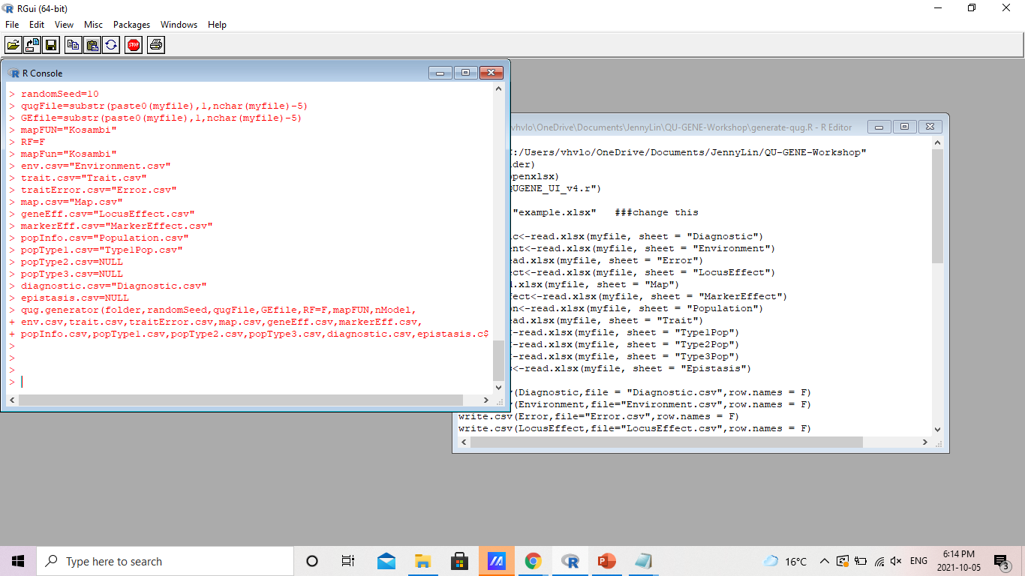
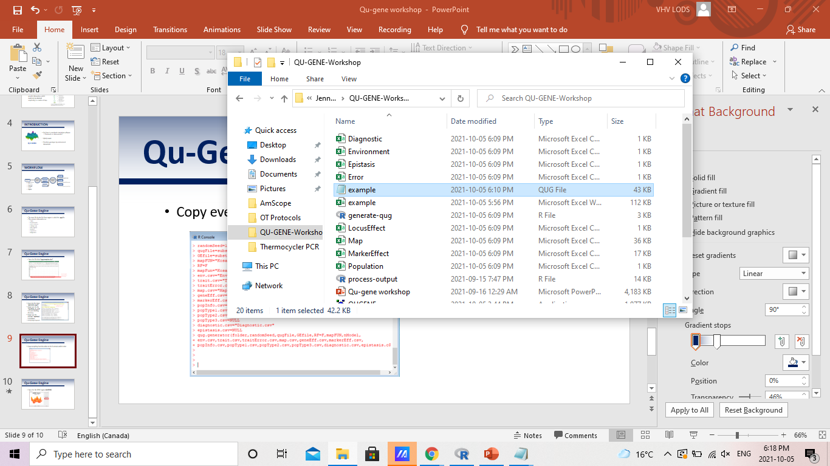
Qu-Gene Engine
Copy everything from the editor to the R console and hit enter

Slide 10
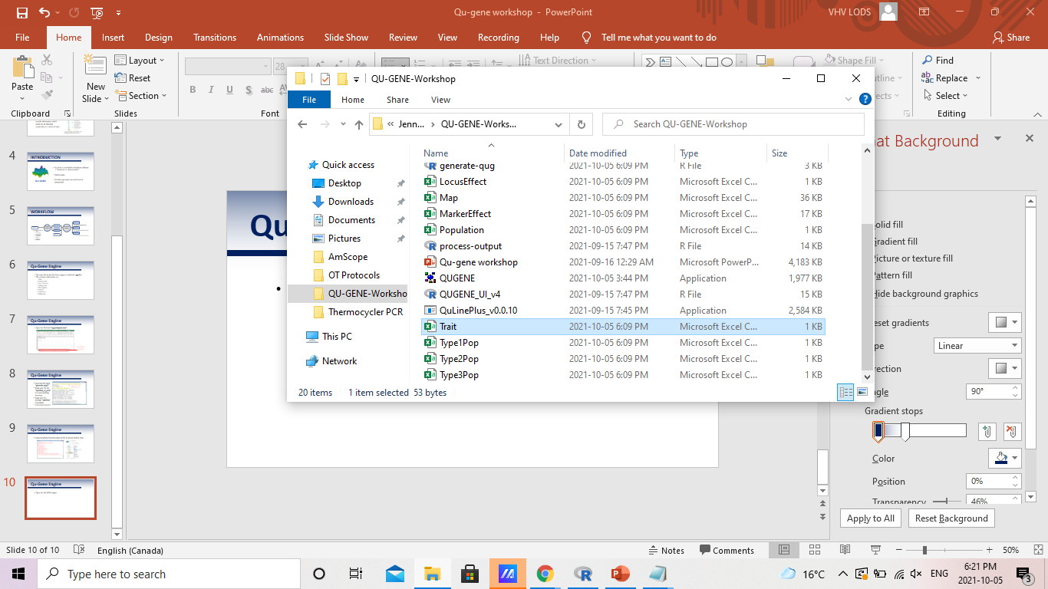
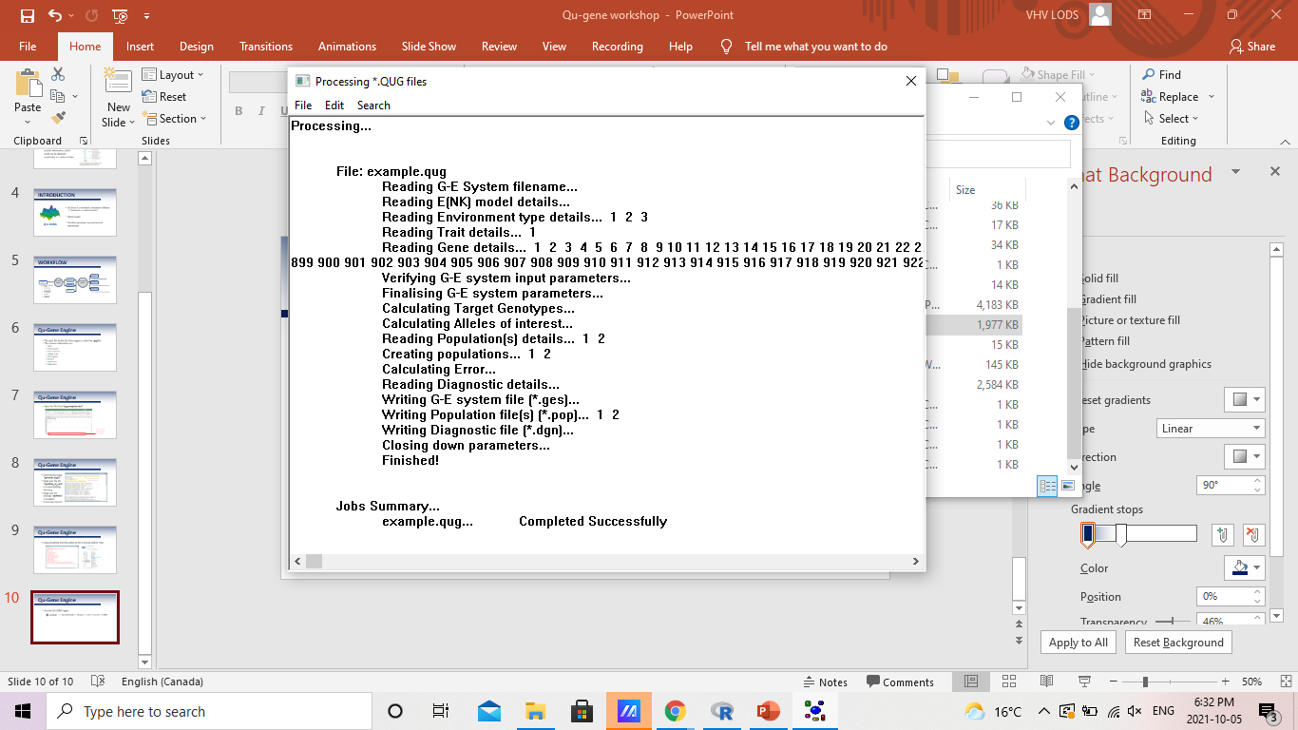
Qu-Gene Engine
Run the QU-GENE engine
>> Run Batch Job >> Browse >> select “example” >> RUN

Slide 11
Qu-Gene Engine
Files generated from running the Qu-Gene engine:
Error.pop
example.dgn
example.ges
Parents.pop

Slide 12
QuLinePlus module
The input files for QuLinePlus include:
.ges file
.pop file
.qmp file
.mio file
Note: after running the Qu-Gene engine, there are two .pop files generated: Error.pop and Parents.pop
QuLinePlus uses the Parents.pop file!
We still need these files

Slide 13
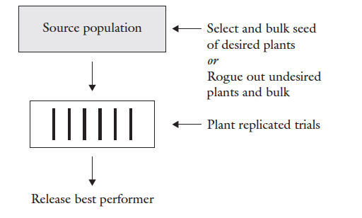
QuLinePlus module
The .qmp file contains information on the breeding strategy you plan to simulate
In our example, we will simulate a simple mass selection scheme
Overview of mass selection. Acquaah, G. (2007) Principles of plant genetics and breeding. 2nd Edition, Wiley-Blackwell, Hoboken.

Slide 14
QuLinePlus module
Open the file titled “mystrategy.qmp” with textedit
How do we read this?
How can we change it to accommodate our own experiments?

Slide 15
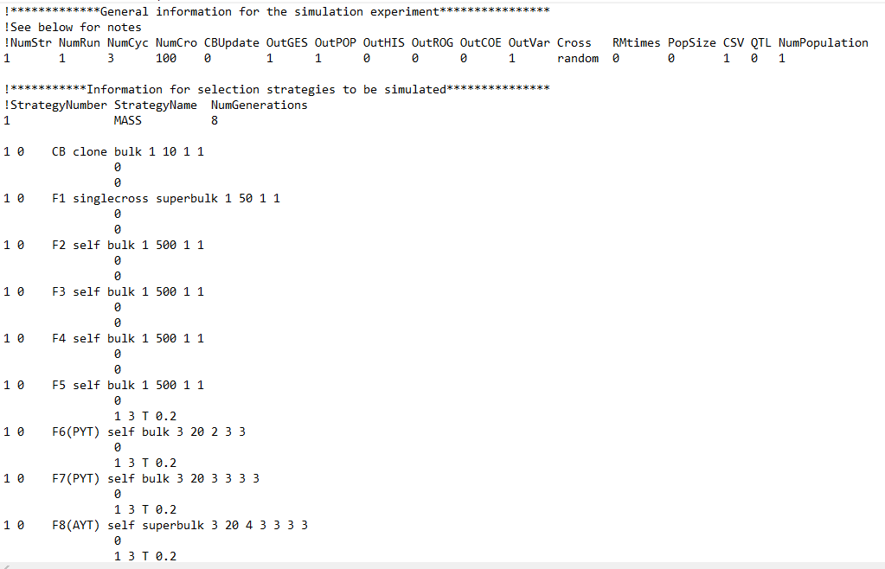
You can choose the number of crosses you want to work with
If you have your own crossing block design, you can choose to add a .pox file
Select the number of cycles you wish to simulate
Select the number of runs (a.k.a. replications) you wish to simulate
Change this number if you have more than one strategy

Slide 16
Note: the number of generations does NOT include the crossing block (CB)
Specification for the location. In our example 1 is the nursery.
Number of locations
Plot size
Number of replications
Method of harvest (i.e. superbulk, bulk, pedigree, partbulk)
Seed propagation (i.e. clone, DH, self, backcross, topcross, doublecross, random, noself)
Generation title
*DH = double haploid

Slide 17
Among family selection
Within family selection
*T = top
B = bottom
M = middle
R = random
TV = top value
BV = bottom value
TN = top number
BN = bottom number
RN = random number
Selection intensity
Selection model (i.e. T, B, M, R, TV, BV, TN, BN, RN)
Trait number (In our example, trait 1 is yield)
Number of traits to be selected

Slide 18
QuLinePlus module
Open a new textedit file
Save as “QuLinePlus.mio”
Type the following and then save the file:
example.ges
Parents.pop
mystrategy.qmp
zOut
Note: make sure to select All files under save as type

Slide 19
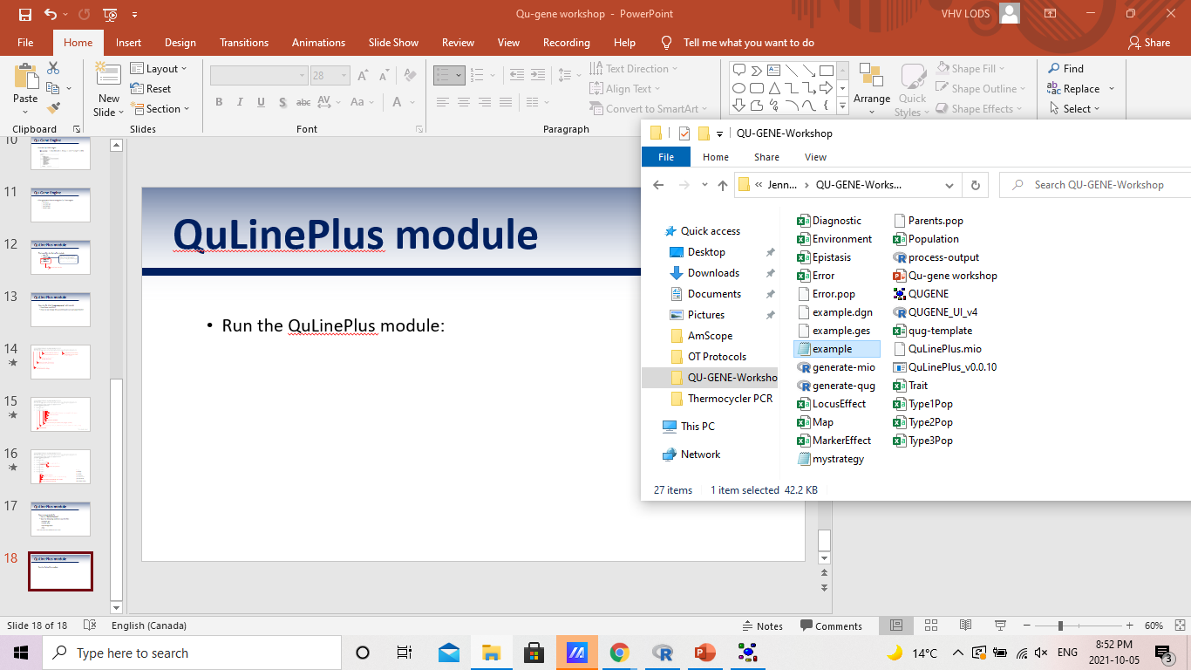
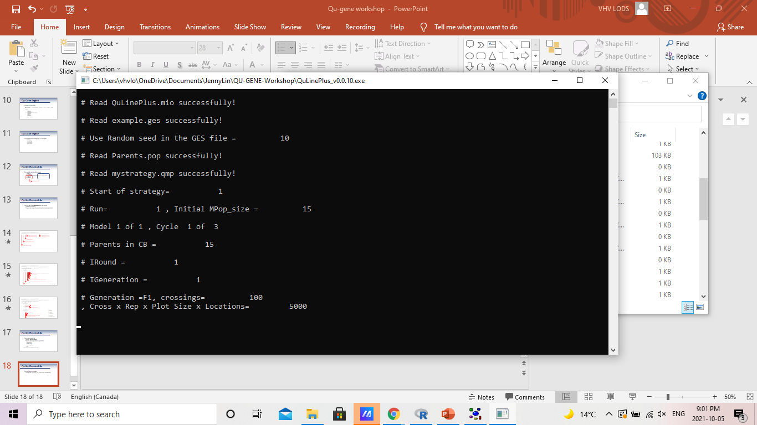
QuLinePlus module
Run the QuLinePlus module
Double click and you will see the following:

Slide 20
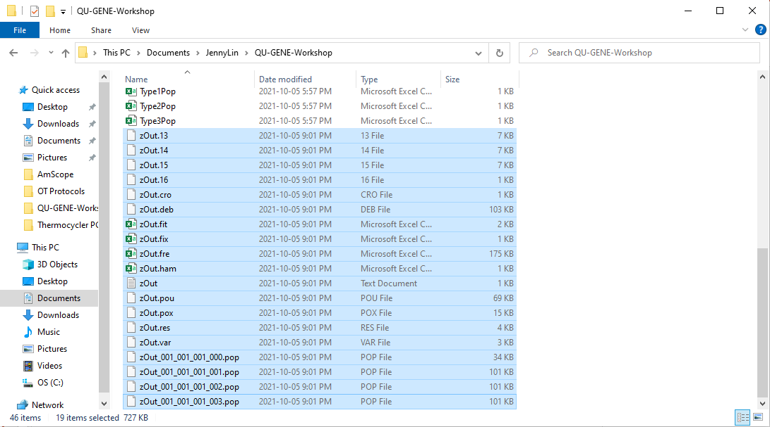
QuLinePlus module
If the run was successful, you should see a number of output files:

Slide 21
Simulation output
We will consider only the following files:
.fit file
Contains the average “fitness” values for the population
Can be used to estimate genetic gain
.fix file
Contains the percentage of favourable and unfavouable alleles that are fixed in the population
.ham file
Contains the Hamming distance for the population
.var file
Provides estimates for the genetic variance

Slide 22
Simulation output
Open the script “process-output.R” in R
### INSTALL THE NEEDED PACKAGES
install.packages("dplyr")
install.packages("ggplot2")
install.packages("ggpubr")
library("dplyr")
library("ggplot2")
library("ggpubr")
### SET YOUR WORKING DIRECTORY
folder = "C:/Users/vhvlo/OneDrive/Documents/JennyLin/QU-GENE-Workshop"
setwd(folder)
### INPUT YOUR TRAIT OF INTEREST
mytrait = "SY"
### INPUT YOUR ENVIRONMENT OF INTEREST
myenv = "Field"
If you don’t have these packages, please install them
Change this to your own working directory
Copy and paste the code to the R console!

Slide 23
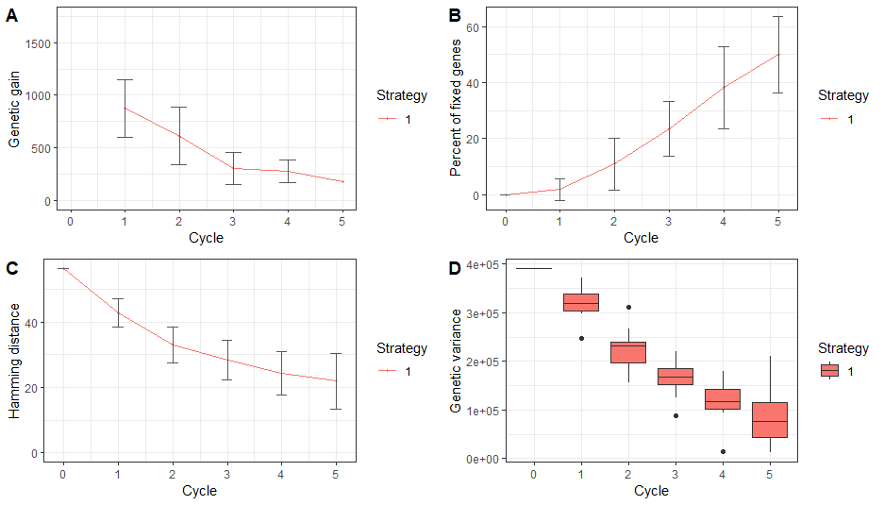
Simulation output

Slide 24
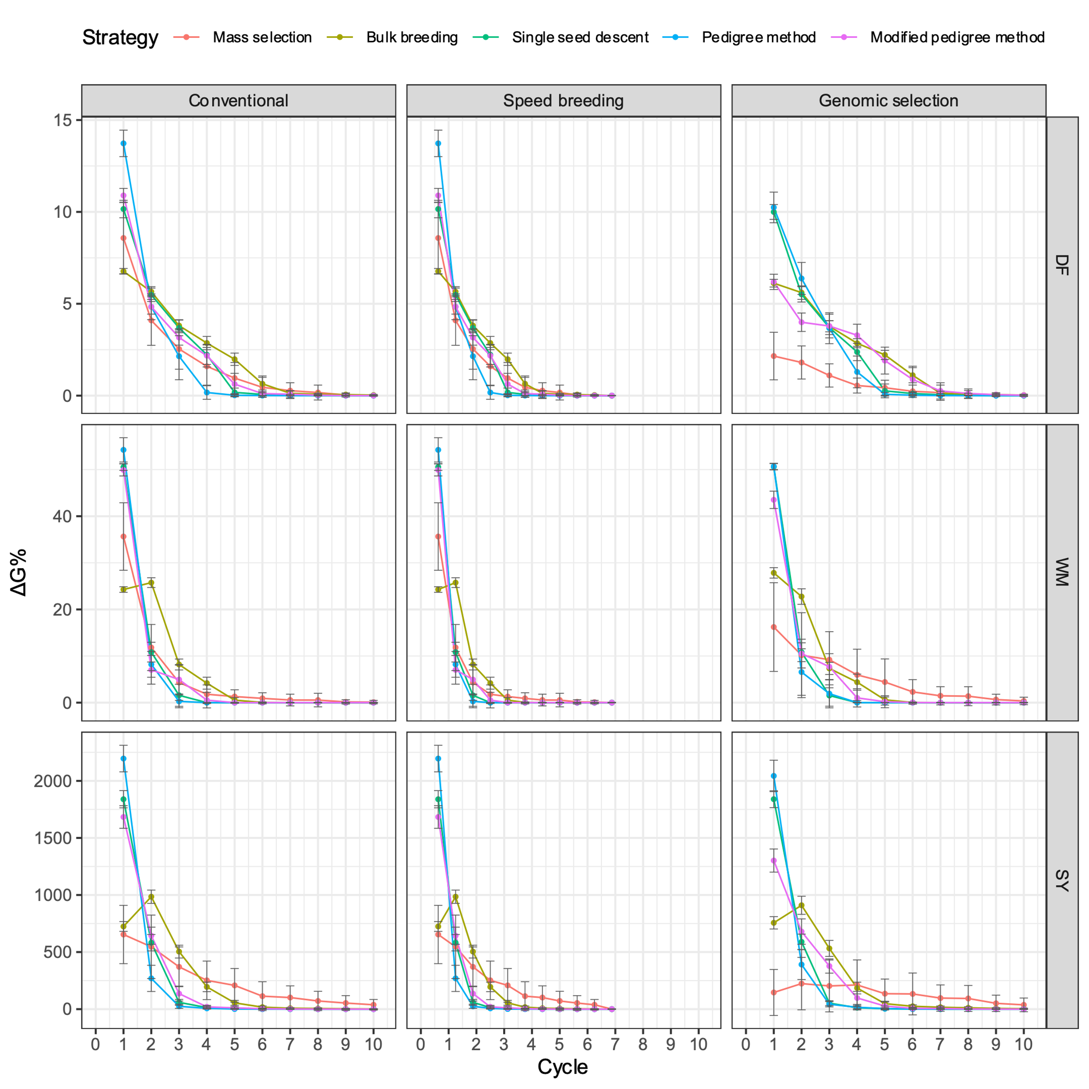
Examples
Figure 1: Comparison of five breeding strategies in terms of genetic gain averaged across 50 runs for 10 cycles of selection in a closed system with 30 initial parents. Traits include days to flowering (DF). white mold resistance (WM), and seed yield (SY). Conventional breeding shown alongside new proposed breeding methods, speed breeding and genomic selection, Error bars indicate standard error.

Slide 25
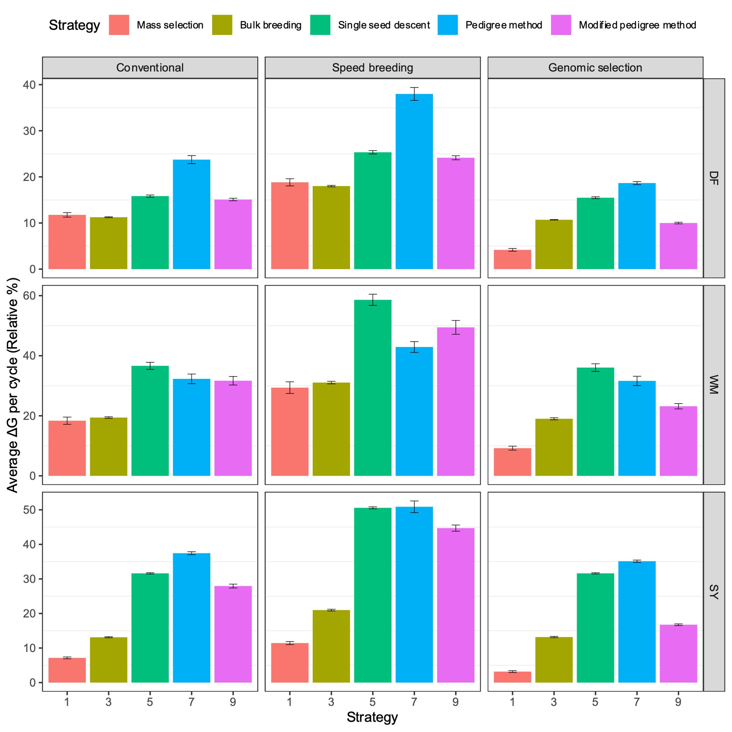
Examples
Figure 2: Comparison of five breeding strategies in terms of average genetic gain per cycle across 50 runs of selection in a closed system with 30 initial parents. Traits include days to flowering (DF). white mold resistance (WM), and seed yield (SY). Conventional breeding shown alongside new proposed breeding methods, speed breeding and genomic selection, Error bars indicate standard error.

Slide 26
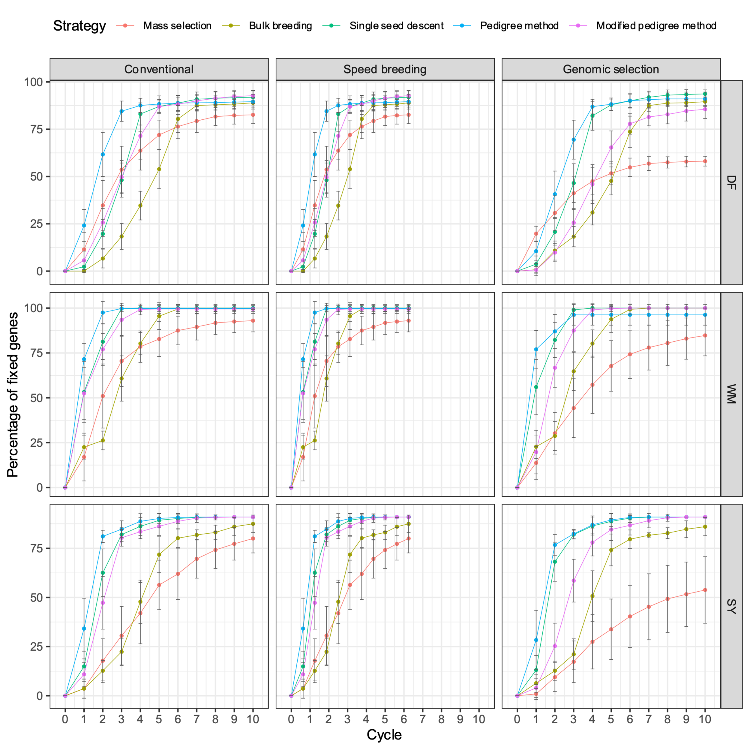
Examples
Figure 3: Comparison of five breeding strategies in terms of fixation of favourable alleles averaged across 50 runs for 10 cycles of selection in a closed system with 30 initial parents. Traits include days to flowering (DF). white mold resistance (WM), and seed yield (SY). Conventional breeding shown alongside new proposed breeding methods, speed breeding and genomic selection, Error bars indicate standard error.

Slide 27
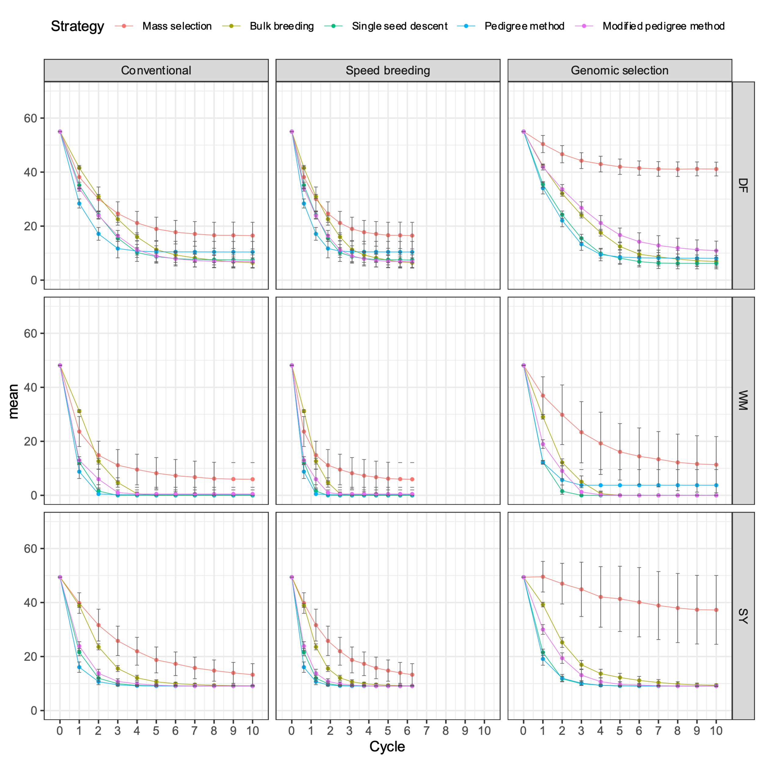
Examples
Figure 4: Comparison of five breeding strategies in terms of Hamming averaged across 50 runs for 10 cycles of selection in a closed system with 30 initial parents. Traits include days to flowering (DF). white mold resistance (WM), and seed yield (SY). Conventional breeding shown alongside new proposed breeding methods, speed breeding and genomic selection, Error bars indicate standard error.

Slide 28
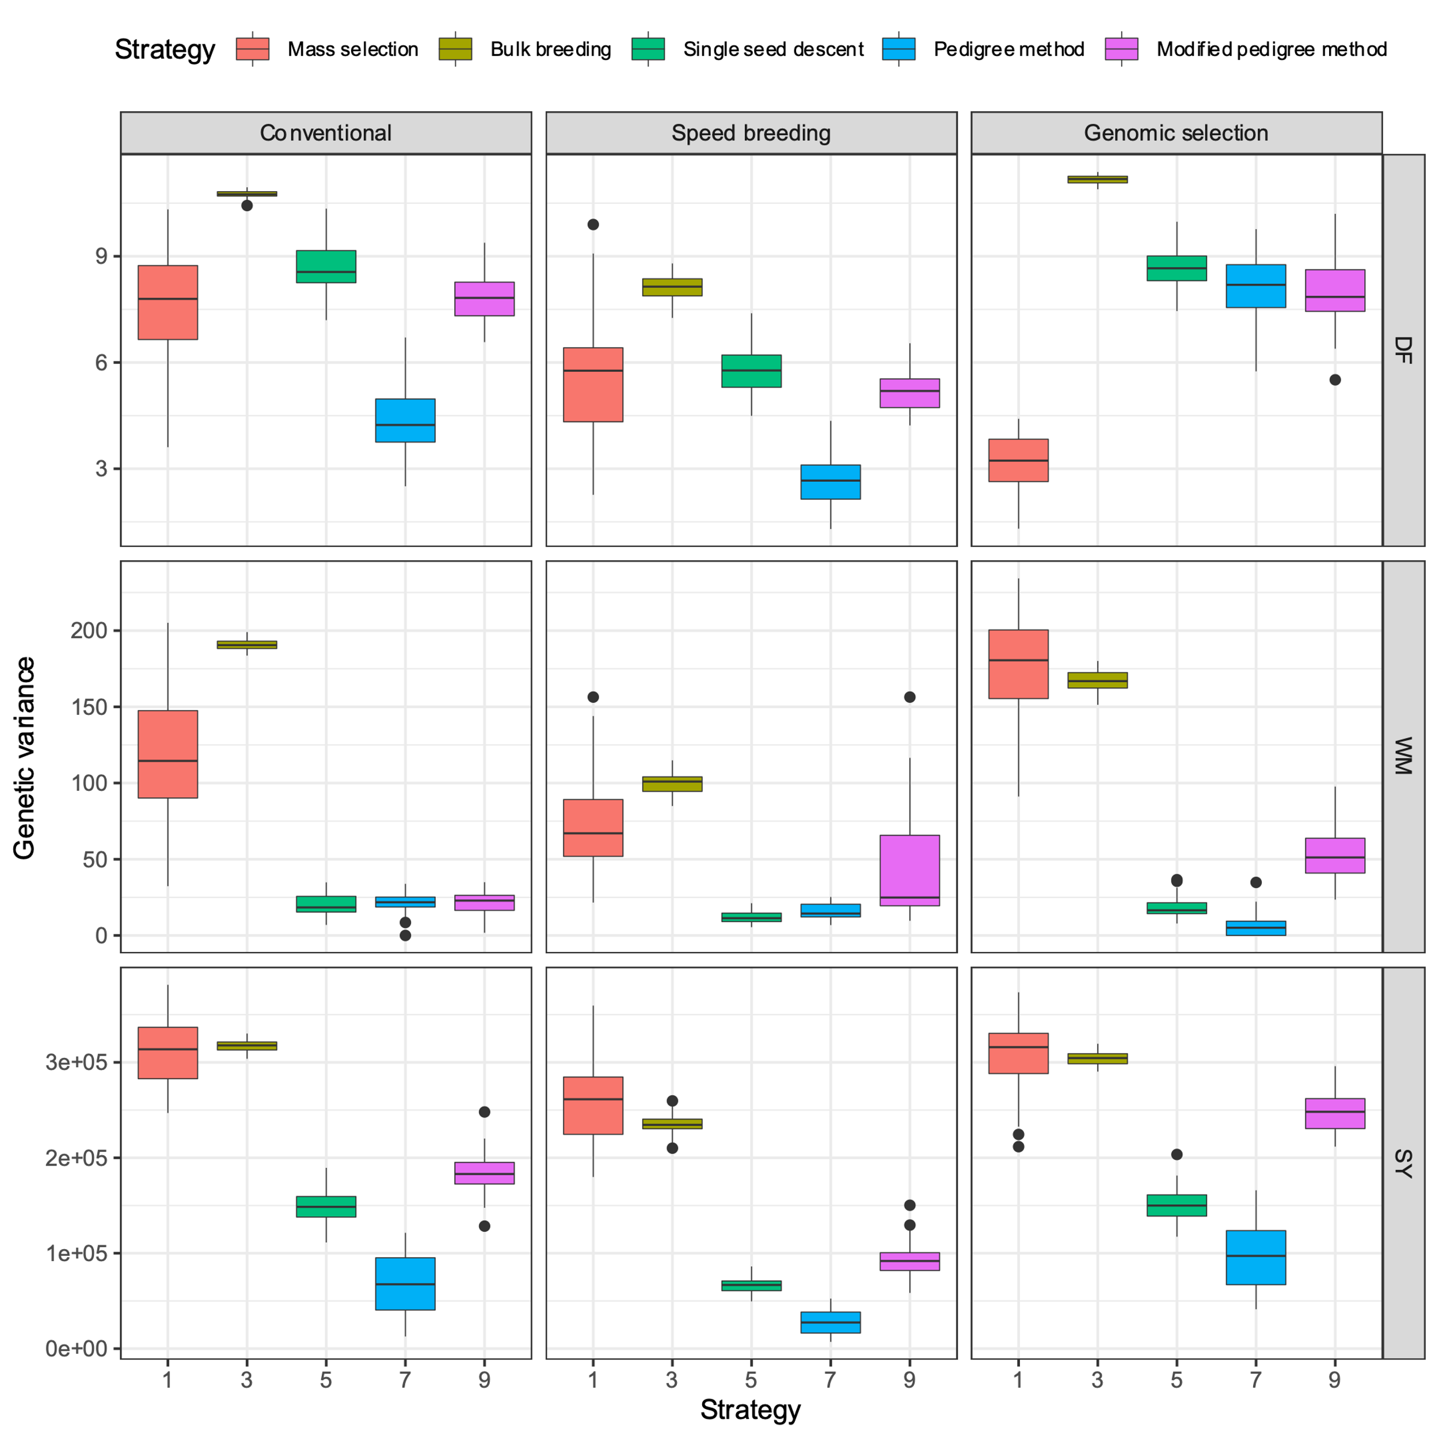
Examples
Figure 5: Comparison of five breeding strategies in terms of genetic variance after the first selection cycle averaged across 50 runs in a closed system with 30 initial parents. Traits include days to flowering (DF). white mold resistance (WM), and seed yield (SY). Conventional breeding shown alongside new proposed breeding methods, speed breeding and genomic selection, Error bars indicate standard error.

Slide 29
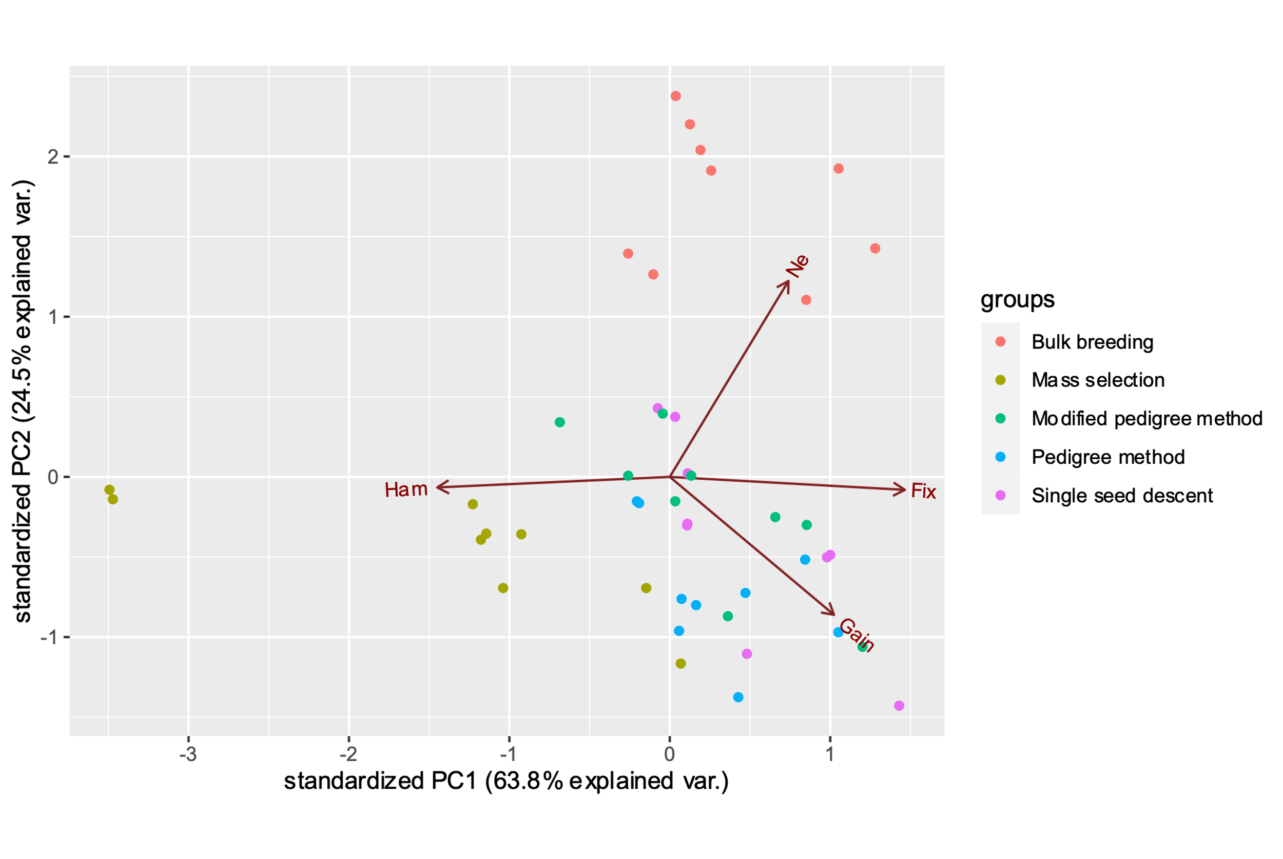
Examples
Figure 6: Principal component analysis (PCA) plot displaying the variation among five breeding strategies in terms of genetic gain variables in a closed system with 30 initial parents. Vectors specify the direction and strength of genetic gain variables. The first two principal axes explained 88.3% of the variance.

